Slide 1
Explaining Credit Card Fraud Decisions in ML
An Analysis of XAI Methods
Ciaran Finnegan – Course: M.Sc. in Computing (Data Science)
Student: D21124026

Slide 2
Motivation + Research Problem
An objective analysis of XAI techniques in card fraud detection/explanation

Slide 3
Motivation
Add your first bullet point here
Add your second bullet point here
Add your third bullet point here

Slide 4
Research Problem – Automate XAI Method Evaluation?
Null Hypothesis:
It is not possible to quantify and distinguish the statistically best interpretation framework to explain the reason for a specific (local) credit card fraud classification result using the following state-of-the-art techniques; SHAP, LIME, ANCHORS, and DICE.
Alternate Hypothesis:
IF a Neural Network algorithm is trained on a credit card transaction dataset for ML fraud detection, and SHAP, LIME, ANCHORS, and DICE interpretability frameworks are applied to individual model results
THEN a test for significance can be applied to the scores of each interpretability framework, against a predefined set of quality metrics, to rank each explainer technique and to demonstrate statistically which is best for explaining local credit card fraud classification results.
SHAP
LIME
ANCHORS
DiCE

Slide 5
Background + Literature Review
Key themes in current research

Slide 6
Background and Literature Review
Key Themes
It is not enough to stop the fraud; the machine needs to tell you why?
How to measure the effectiveness of an explanation? What makes it good? Consensus is hard to find.
Humans can give you their assessments – but they can be expensive, stupid, or prejudiced (or all three).
Can the value of XAI output, particularly from an NN ‘black box’, be assessed using an objective/statistical process?

Slide 7
Experiments: Design + Methodology
Research objectives

Slide 8
XAI: Custom Metrics to Score Each Technique
First bullet point here
Second bullet point here
Third bullet point here
Step 1 Title
Step 2 Title
Step 3 Title
Task Description
Task Description
Task Description
Task Description
Task Description
Task Description

Slide 9
Experiments: Implementation
Generating and evaluating XAI custom metrics

Slide 10
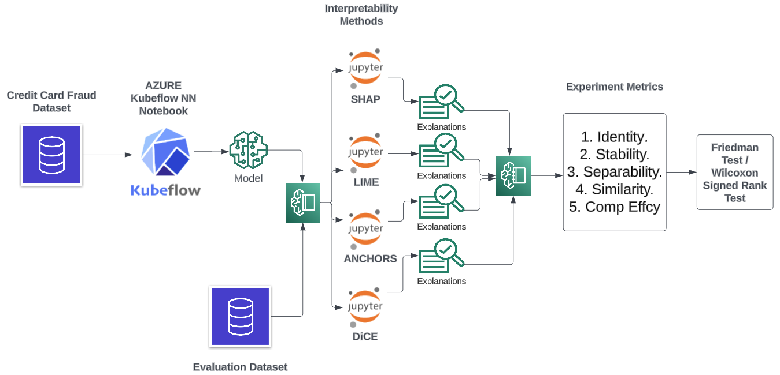
Experiment Structure
First bullet point here
Second bullet point here
Third bullet point here

Slide 11
Pre-Experiment Question: Meaningful XAI Output?
Add your first bullet point here
Add your second bullet point here
Add your third bullet point here

Slide 12
Experiments: Results
What do the experiments reveal?

Slide 13
XAI Metric Scores
Add your first bullet point here
Add your second bullet point here
Add your third bullet point here

Slide 14
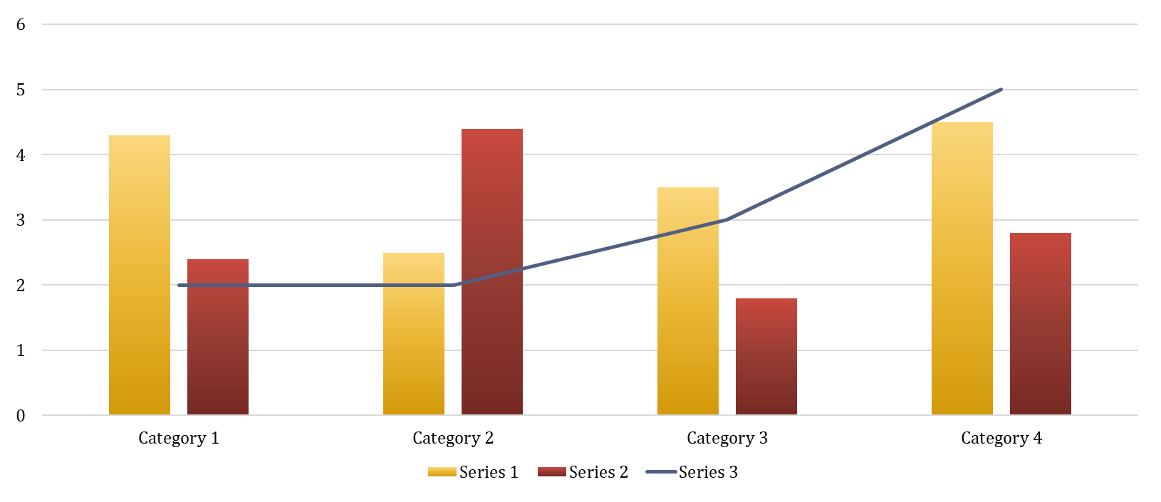
Statistical Analysis of XAI Scores

Slide 15
Contribution + Impact
What insight do the outcomes provide?

Slide 16
Contributions and Impact
The experiments were successful in building an objective statistical framework to compare XAI methods, but…
Would it be enough to convince a financial crime Product Manager to forgo human-centric survey? Perhaps, but the scope of the experiments needs to increase.
If SHAP has no obvious competitor for ‘good’ explanations – why keep looking?
The interaction of the XAI methods with the credit card dataset must be to considered in parallel with the custom metric results.
Why did Anchors take so long to compute?
Why did DiCE require additional features, etc.?

Slide 17
Future Work + Recommendations
Quo Vadis?

Slide 18
Future Work and Recommendations
Broaden XAI methods to improve insight on how new explainability procedure perform on the credit card data.
The experiment structure provides an effective, consistent, and repeatable framework into which to ‘plug’ other interpretability techniques (LORE, ILIME, MAPLE, etc.), and new datasets.
Create new custom metrics to increase range of automated criteria designed to rate a ‘good’ explanation.

Slide 19

Questions?

Slide 20
Add a Slide Title - 1

Slide 21
Research Problem

Slide 22
Add a Slide Title - 3

Slide 24
Add a Slide Title - 4

